Slide 1
CDS321 Applied Project
Eric Wu

Slide 2
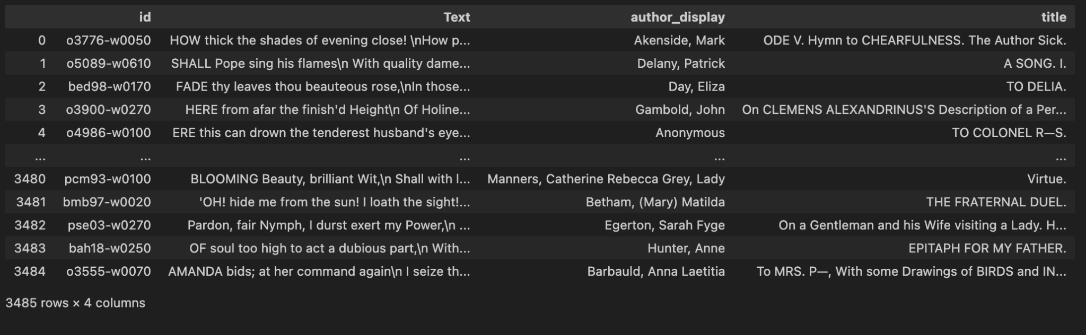
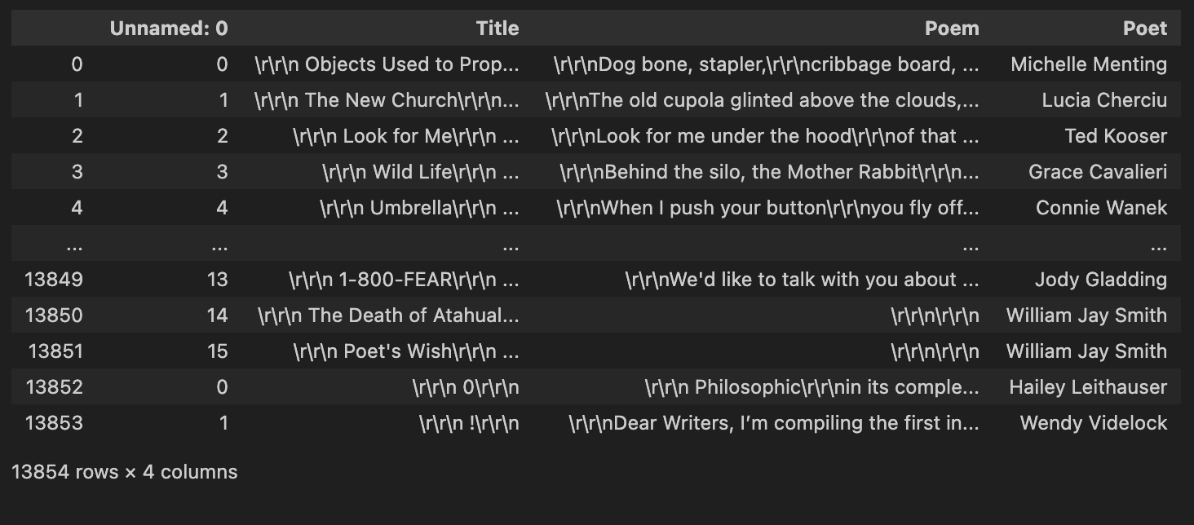
Datasets Used
Eighteenth Century Poems Dataset was created by the Text Creation Partnership from Gale’s Eighteenth Century Collection Online. This dataset contains eighteenth like its namesake.
The dataset has 3,485 poems and the columns: id, text, author, and title.
Poetry Foundation Dataset by the Poetry Foundation. This data set contains poems from the late 20th and 21st centuries.
The dataset has 13854 poems and the columns id, title, poem, and Poet.

Slide 3
Project Goals/Literature Review
The goal of this project was to employ NLP techniques to analyze the changes in English language poems from the 18th century to the 21st.
The secondary goals of this project were: identifying changes in language, changes in grammars, and the changes in length or scope of poetry throughout the selected time frame of my project.
Literature pertaining to using NLP to analyze poetry:
1.Understanding poetry using natural language processing tools: a survey by Mirella De Sisto, Laura Hernández-Lorenzo, Javier De la Rosa, Salvador Ros, & Elena González-Blanco
-This paper is specifically about tools used in automatic poetry analysis in one time period.
2. Natural Language Processing used in sentiment analysis of poetry: a study of six common techniques by Tanya Nair
-This paper tested the accuracy of 6 NLP techniques on the Poem Emotion Recognition Corpus
3.Using Natural Language Processing to discover themes in First World War poetry by Rob
-This paper analysed the themes of WW1 Poetry by finding the most common words of each poem.

Slide 4
Preprocessing + Methodology
1. Scrape the EC poems online
2. Read the EC poems to a DF
3. Read in the PF poems to a DF
4. Clean the text
  Remove non-poem lines
  Remove unnecessary spaces
  Remove non a-z0-9 and \n
  Remove any other odd characters found using set()
  Remove roman numerals from the EC poems
  Lowercase all the text
  Split poem lines in to lists of lines
5. EDA: Identify most common words from each dataset
6. POS tag DFs and compare tags (using NLTK.pos_tag)
7. Identify various statistics about the poems in the DFs
8. Implement sentiment analysis (used the VADER corpus)
9. Metrical Analysis
Notes:
I used os (file open) and regular expressions to read in the poem files for ec poems and manually pulled the poetry foundation poems using an api.
I then read the csv files into pandas to transform the data.
I mainly used regex and nltk packages to remove stopwords for some analyses, stem, lemmatize, tokenize and find sentiment.

Slide 5
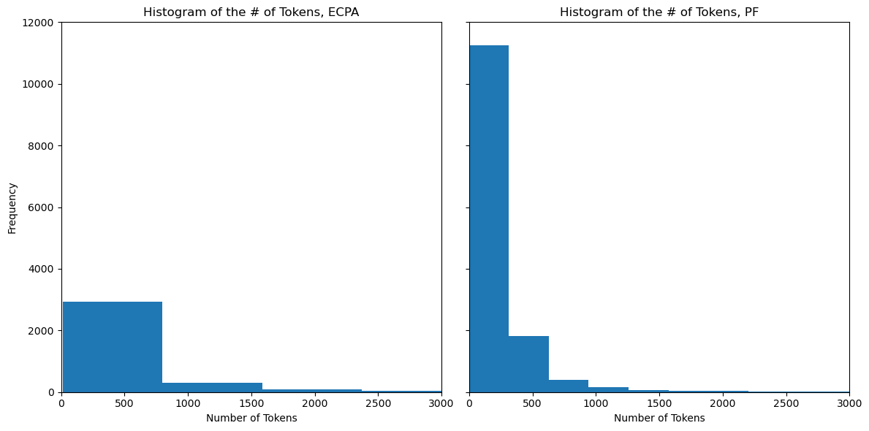
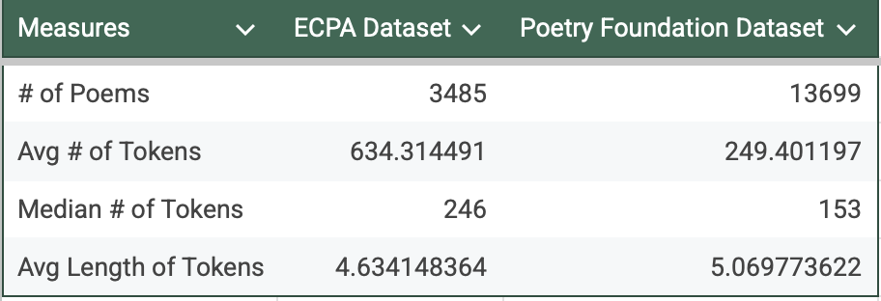
EDA Findings
This table represents an analysis of the mean, median, and average length of the number of tokens contained in the corresponding dataset after data cleaning
The ECPA dataset typically had:
-Longer poems & shorter tokens
The PF dataset typically had:
-Significantly shorter poems & longer tokens
From the histogram representing the distribution of the number of tokens per poem for each dataset, we can see,
The vast majority of the poems in ECPA fall between 0 and 750 tokens, while the PF poems were significantly shorter, with most having less than 250 tokens a poem

Slide 6
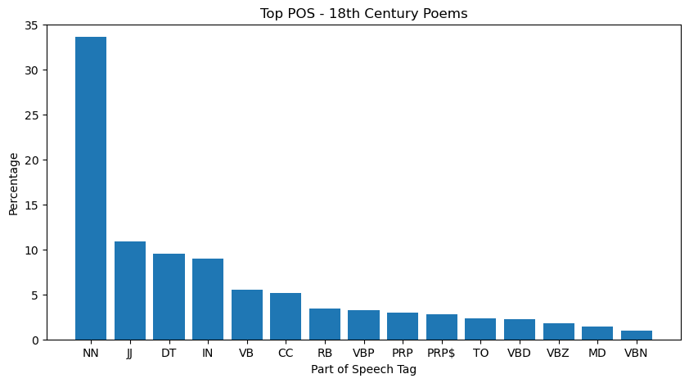
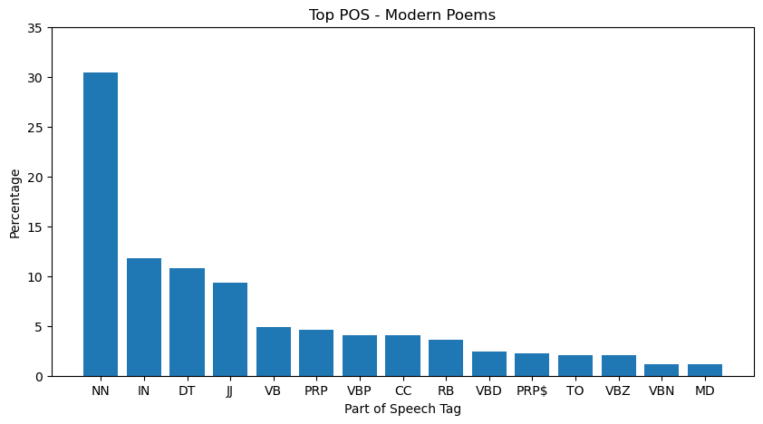
POS Findings
This bar chart represents the distribution of POS in the ECPA dataset ordered by occurrence for the top 15 POS.
While the percentage of most parts of speech has remained relatively constant, jj was used more for the EC poems.
The use of nouns in EC poems was slightly higher than modern poems. This may be due to people in the EC writing about a particular subject, rather than a feeling or something figuratively.
This bar chart represents the distribution of POS in the ECPA dataset ordered by occurrence for the top 15 POS.
This chart shares similarities with the EC poem chart. The top 5 POS tags are shared amongst the graphs, however, the proportions of the POS after the top 5 change significantly afterwards. This may be due to more poems in the PF dataset containing more creative uses of grammar
Notes:
CC: conjunction, coordinating
DT: determiner
IN: preposition or conjunction, subordinating
JJ: adjective or numeral, ordinal; JJR: adjective, comparative; JJS: adjective, superlative
MD: modal auxiliary
NN: noun, common, singular or mass; NNP: noun, proper, singular; NNS: noun, common, plural.
PRP: pronoun, personal; PRP$: pronoun, possessive
RB: adverb
TO: "to" as preposition or infinitive marker
VB: verb, base form; VBD: verb, past tense; VBG: verb, present participle or gerund; VBN: verb, past participle; VBP: verb, present tense, not 3rd person singular.; VBZ: verb, present tense, 3rd person singular.
https://stackoverflow.com/questions/15388831/what-are-all-possible-pos-tags-of-nltk

Slide 7
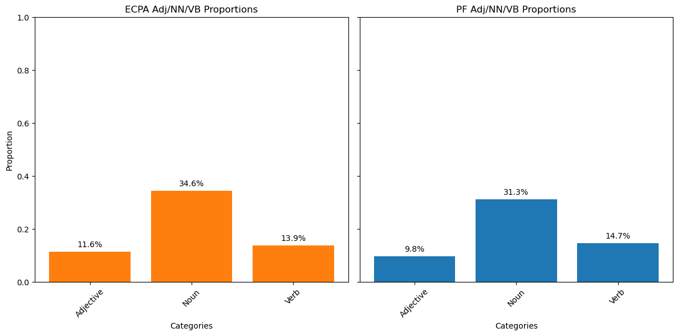
POS Findings
**This chart’s categories where created by selecting all tags that were adjectives, nouns, and verbs, rather than their singular forms as identified on the previous slide.
As highlighted in the earlier slide analyzing the top 15 POS by proportion, The EC poems tended to use more nouns and adjectives.
An interesting finding here that was not visible in the previous set of bar charts is that modern poems use slightly more verbs.
This chart represents the distributions of just the adjectives, nouns, and verbs parts of speech, so the percentage will not add to 100% for the distributions.
Notes:
Overall there is not a large difference in jj/nn/vb at a macro level.

Slide 8
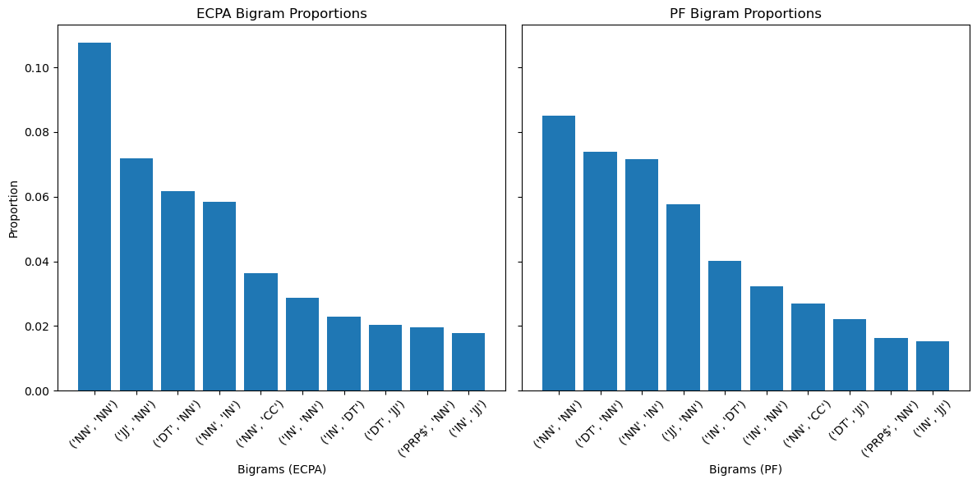
POS Findings: Bi-Grams
The ECPA dataset poems tended to use more (NN,NN) bigrams at 10.78% compared to the PF poems at 8.5%
The interesting thing to note is the difference in distributions of the types of bi-grams per poem and the order that changes when looking at EC poems and modern poems
An additional thing to note is the change in how (DT,NN) had become more common in the modern poems. (NN,CC) also used to be more common in EC poems.
This barchart represents the top 10 most common POS bi-grams by proportion

Slide 9
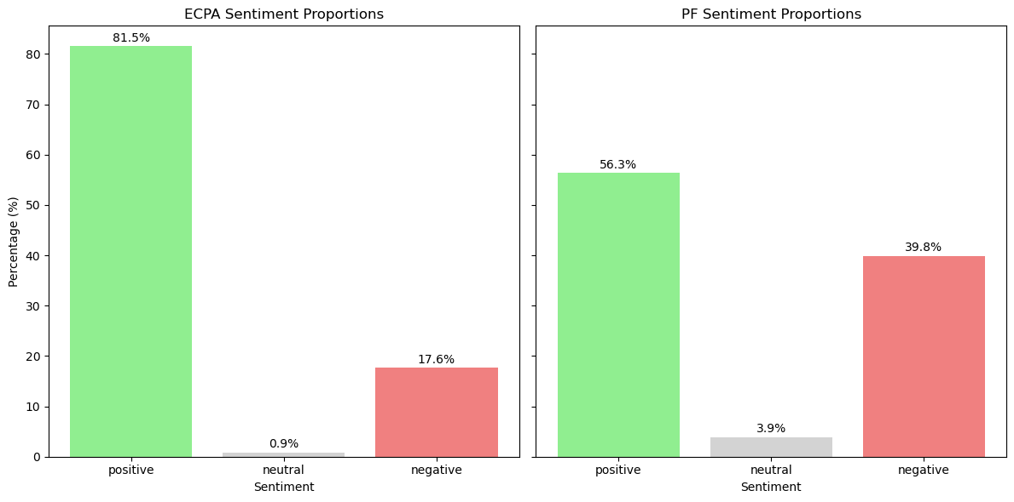
Sentiment Findings
The EC poems had significantly a very different distribution of poems based on sentiment category compared to PF.
Because of the use of a per word approach when using the vader_lexicon to identify sentiment, the word embeddings and nuances of semantics are not captured. There is a chance the categories are not completely representative.
The threshold used to identify positive, neutral, or negative sentiment was 0.05.
This bar chart represents the sentiment categories by percentage found using the NLTK vader_lexicon for each dataset

Slide 10
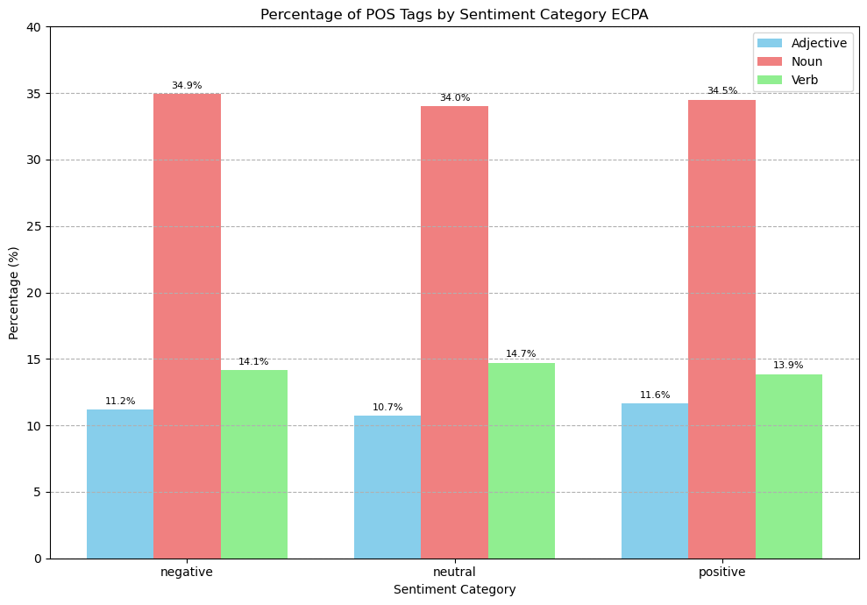
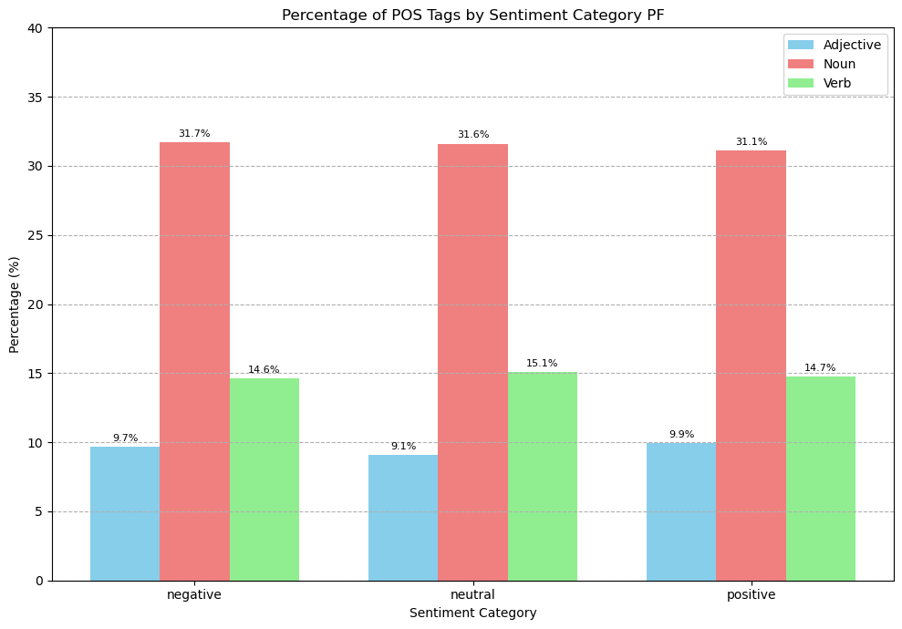
Sentiment Findings and POS Distributions
This bar chart represents the POS distributions of Adjectives, Nouns, and Verbs by their respective sentiment category for the ECPA dataset.
The trends found for the overall distribution for adj/Nn/Vbs in the POS findings slide remains true even when plotting by sentiment category. It seems the writing style and grammar used in the EC is universal when writing negative, neutral, or positive poems.
This bar chart represents the POS distributions of Adjectives, Nouns, and Verbs by their respective sentiment category for the PF dataset.
The same trend found in the comparison of the PCT of POS tags by sentiment category for the ECPA dataset applies to the PF dataset. It seems the sentiment of the poem does not change the fundamental way we write, even with respect to time. As the PF distribution with respect to sentiment is consistent with the previous distribution without.

Slide 11
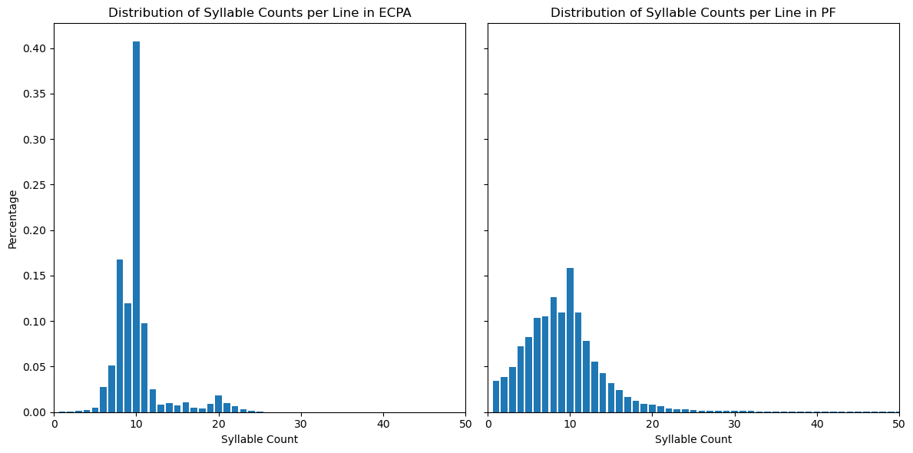
Metrical Analysis (Syllable Counts)
The EC poems tended to have a larger proportion of lines that had a syllable count of 10, whereas the modern poems had a more gaussian distribution.
The EC poems also had another center near 20 syllables per line, whereas the modern poems exhibited a logarithmic style drop off after a syllable count of 10.
This chart represents the percentage per syllable count, extracted from the original poem text, counting the syllables per line by dataset
Notes:
I derived syllable counts from lines, using ‘\n’ as the criteria for each line.
I then used the cmudict corpus to get syllable counts for words and used a simple rule based approach to estimate words’ syllable counts that were not in the corpus
else: #handle words not in cmu_dict
vowels = "aeiouy"
count = 0 # vowels count
if word[0] in vowels:
count += 1
for index in range(1, len(word)):
if word[index] in vowels and word[index - 1] not in vowels:
count += 1
if word.endswith("e"):
count -= 1
if word.endswith("le"):
count += 1
return max(1, count) # Ensure at least one syllable

Slide 12
Conclusions
Overall it seems the changes in the POS and sentiment of poems is likely due to the changes in poem subject matter, changes in grammar from the eighteenth century to modern times, and the change in they way ordinary people are literate compared to the eighteenth century where only people who were highly educated were literate. There is also a trend towards shorter poems, with fewer lines, that contain more variety to the POS used, assuming the tagger was mostly accurate.
There is a lot of research needed in the use of NLP to analyze poetry. Due to the inherent nature of a computer’s limits set out by the limitation of our programming, the comprehension of poetry is not within the scope of a computer’s ability maybe ever.

Slide 13
Questions?

Slide 14
References
Mirella De Sisto, Laura Hernández-Lorenzo, Javier De la Rosa, Salvador Ros, Elena González-Blanco, Understanding poetry using natural language processing tools: a survey, Digital Scholarship in the Humanities, Volume 39, Issue 2, June 2024, Pages 500–521, https://doi.org/10.1093/llc/fqae001
Nair, T. (2023). Natural Language Processing used in sentiment analysis of poetry: a study of six common techniques. Journal of Student Research, 12(2). https://doi.org/10.47611/jsrhs.v12i2.4418
https://rforjournalists.com/2019/11/08/using-natural-language-processing-to-discover-themes-in-first-world-war-poetry/

